Slide 1
An Exploration into a Chess Minimax Algorithm Implemented in an Object-Oriented Language
BABEŞ-BOLYAI UNIVERSITY CLUJ- NAPOCA
FACULTY OF MATHEMATICS AND COMPUTER SCIENCE
SPECIALIZATION COMPUTER SCIENCE
Supervisor,
Lect. Dr. Cojocar Dan
Author,
Crăciun Ioan Flaviu

Slide 2
I. Motivation and Description
Most top chess engines are written in C++
Modern high-level languages could facilitate complex programs
This thesis makes use of Kotlin, one of the newest such languages
Could Kotlin enable the engine to perform at a high level?
To find out, a client-server application was setup to interact with the engine
Client side in Angular, server side in Kotlin with Spring Boot
Several optimizations implemented on top of minimax
A capable adversary, requiring thought and strategy

Slide 3
II. Other Chess Engines
Stockfish
Traditional backtracking engine
Has long been the undisputed king in the field
AlphaZero
New neural network approach from Deepmind
Much superior to Stockfish
Leela Chess Zero
Community, open-source project
Same idea as AlphaZero, but not kept secret by a company

Slide 4
III. Techniques and optimizations
Alpha-Beta Pruning
Iterative Deepening
Quiescence Search
The Transposition Table
Parallelization

Slide 5
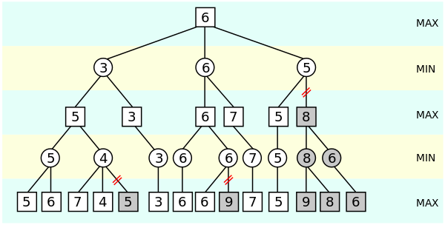

Alpha-Beta Pruning
Best case: O($√b^{d}$)
Worst case: O($b^{d}$)
In practice runtime is reduced to ~$\frac{1}{4}$ of simple minimax

Slide 6
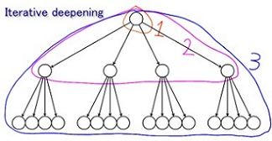

Iterative Deepening
Redo the search for each fixed depth
The time spent on last level will dominate overall runtime
O($b^{1}$+$b^{2}$+…$b^{d}$) = O($b^{d}$)

Slide 7
Quiescence Search
Minimax is susceptible to the horizon effect
Analyzing positions until they are quiet
Quiescence typically dominates runtime
Analysis of performance is tricky

Slide 8

Transposition Table
Technique from dynamic programming
Cache already visited nodes’ evaluation to avoid redundant computations
Around $\frac{1}{2}$ runtime speedup over base minimax

Slide 9
Parallelization
Difficult to parallelize alpha-beta
Parallelized first two calls, sequentially solving the rest
Slight improvement, ~30% reduction in runtime

Slide 10
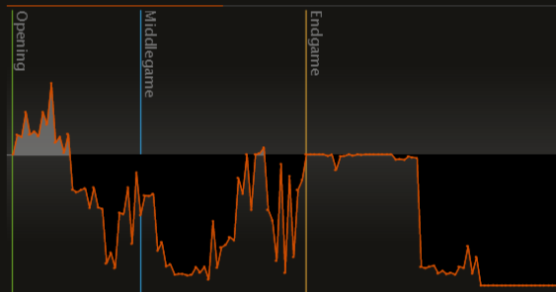
IV. Game Against Stockfish
Engine played against Stockfish level 4
Quiescence, Alpha-Beta and Transposition Table were enabled
Impressive performance
Despite bad positional play, it picks up on tactics pretty well

Slide 11
V. Difficulties & Further Work
Difficulties
Chess has many tricky corner cases, difficult to handle all
First iterations worked badly, tricky to fine tune parameters
Further work
Chess engines are a field rife with research opportunities
Better heuristics
Better parallelization
Machine learning (e.g. neural networks or evolutionary algorithms)

Slide 12
VI. Conclusion
Kotlin can indeed be effectively used to implement a chess engine
Not all optimizations yield great improvements
The performance is impressive for the techniques implemented

Slide 13
Thank you!

